Slide 1


We Care

Slide 2

Contributors
# TEAM
Aarti Mehta:
1566374 mehta.aar@northeastern.edu
Siddhartha Savant:
1568075 savant.si@northeastern.edu
Tejas Bawankar:
1590464 bawankar.t@northeastern.edu

Slide 3
Proposed Solution
The We Care system is an ecosystem which bridges the gap between population and the essential sectors of healthcare and incident response under one centralized framework
The key highlight of this system is that it helps patients with blood disorder to get donors for their treatment
Users can report emergencies and seek immediate response to the casualty using the "Emergency Services" feature

Slide 4
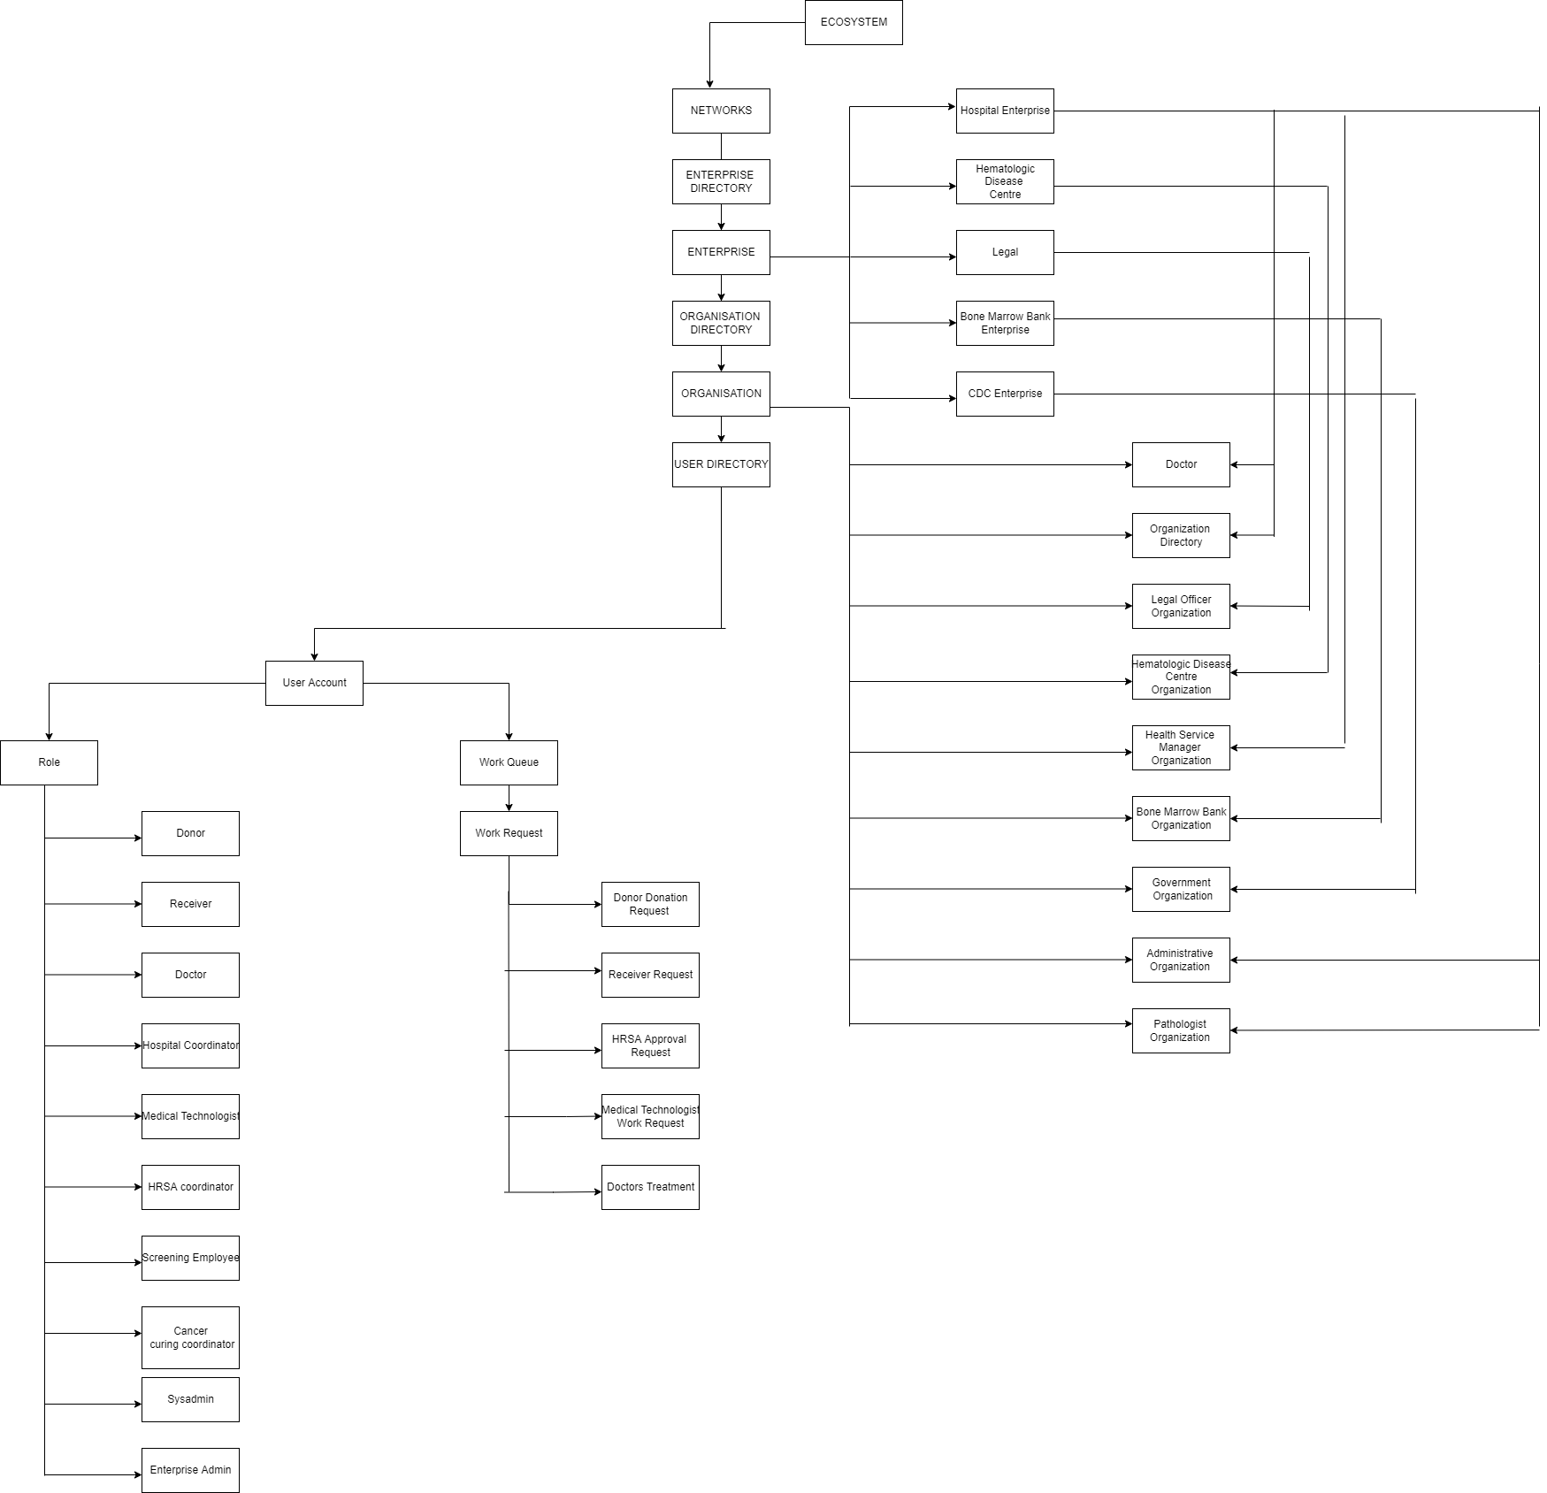
System Architecture

Slide 5
Salient Features
User centric hematology care
Regulate organization requests like doctor appointment, donor, hematology disease center organization etc. centrally by network
Workflow request around the Donor, Receiver, Doctor and respective entities
User can check status for all their requests
User will receive Email and SMS notifications for their requests

Slide 6
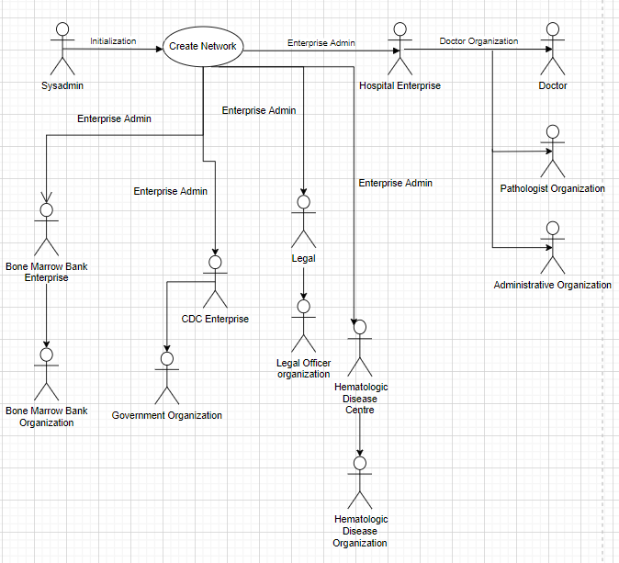
System Admin Sequence Diagram

Slide 7
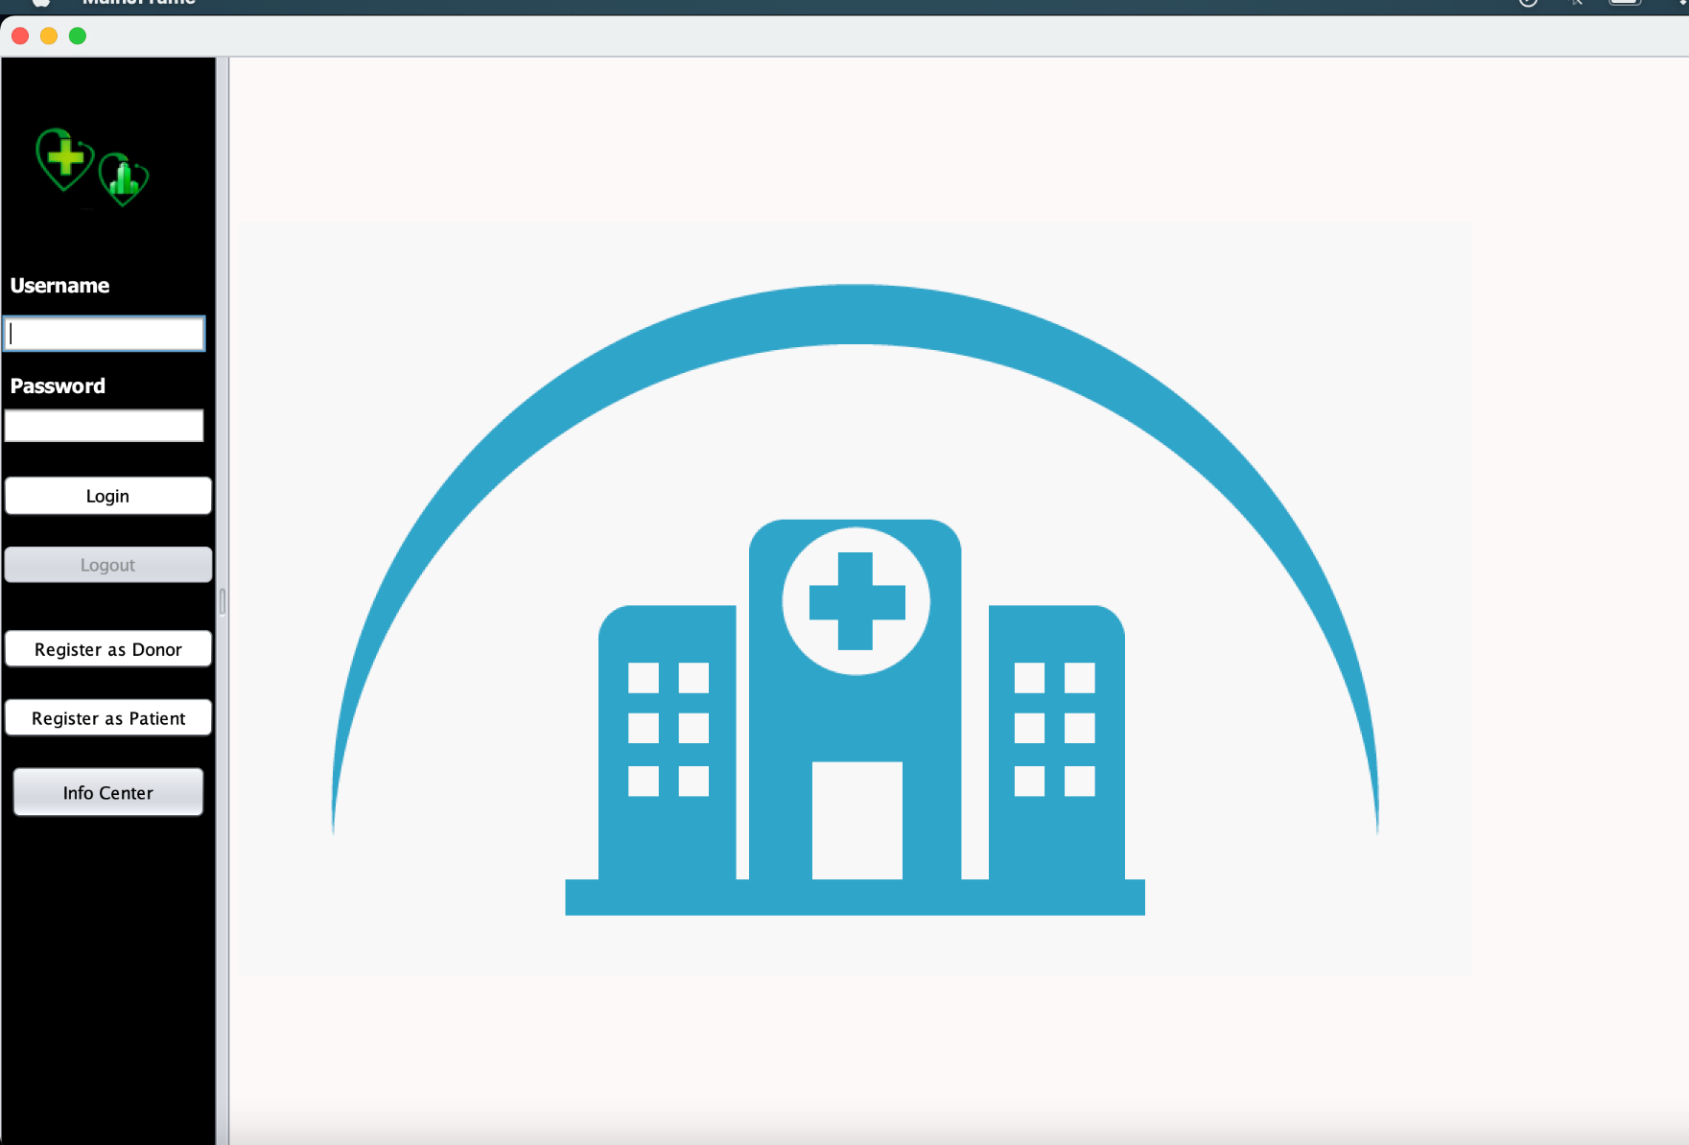
Login Page

Slide 8
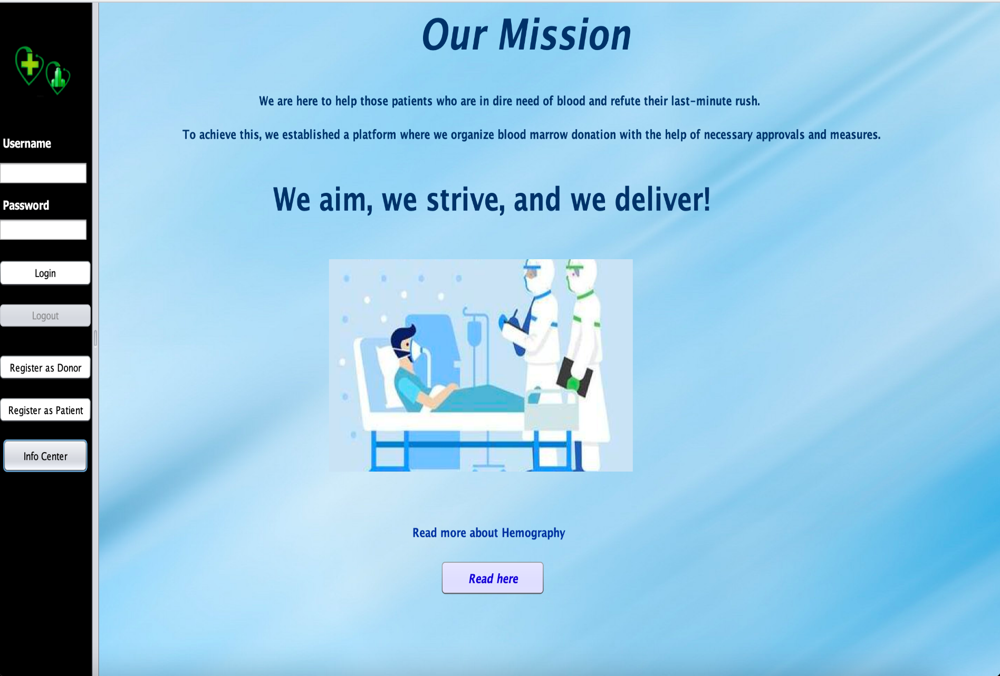
Login Page

Slide 9
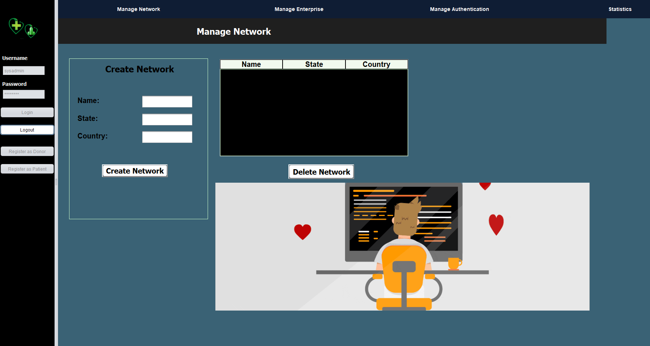
System Admin Work Area

Slide 10
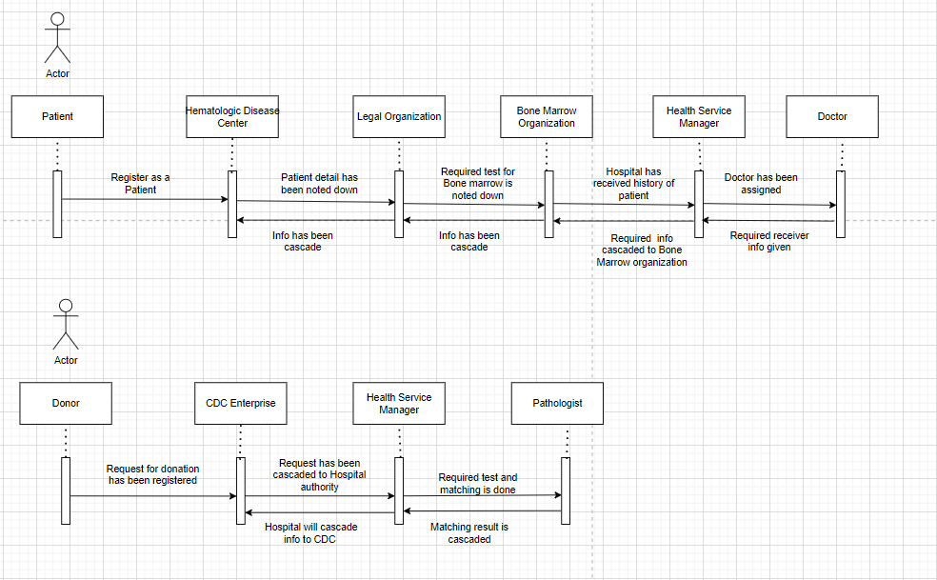
Work Requests Sequence Diagram

Slide 11
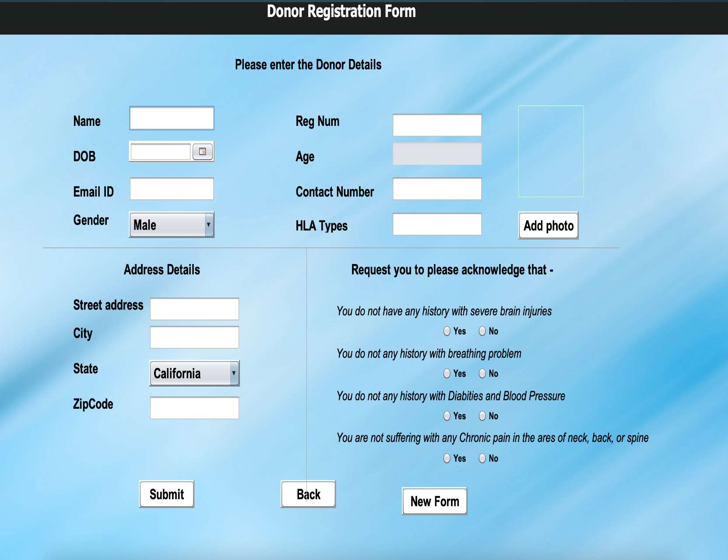
Donor Registration Form

Slide 12
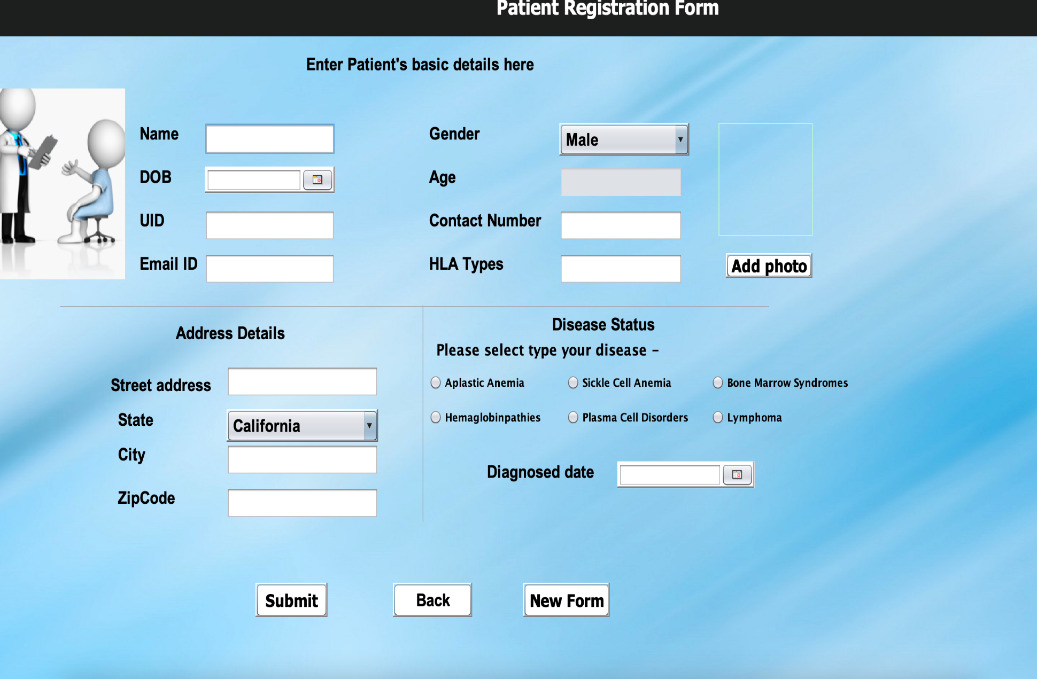
Patient Registration Form

Slide 13
Thank you
Git Hub Link :
https://github.com/knightfox11/We_Care

